Slide 1


Modeling of Thermal Power Plant for multi-output prediction using Artificial Neural Networks
by
Safwan Mondal
Subramanian Ramasamy
Partha Sarathi Dutta

Slide 2
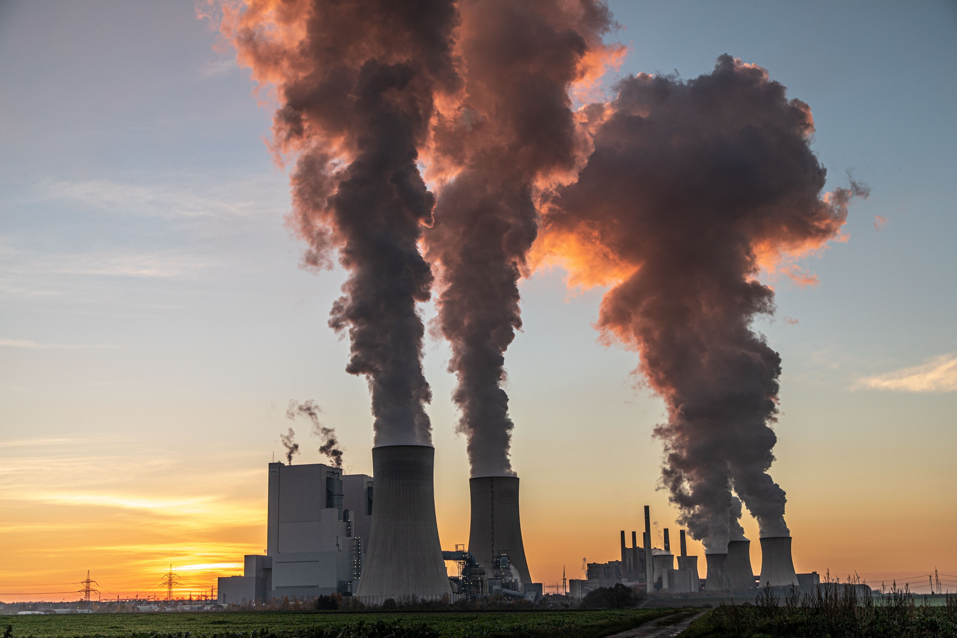
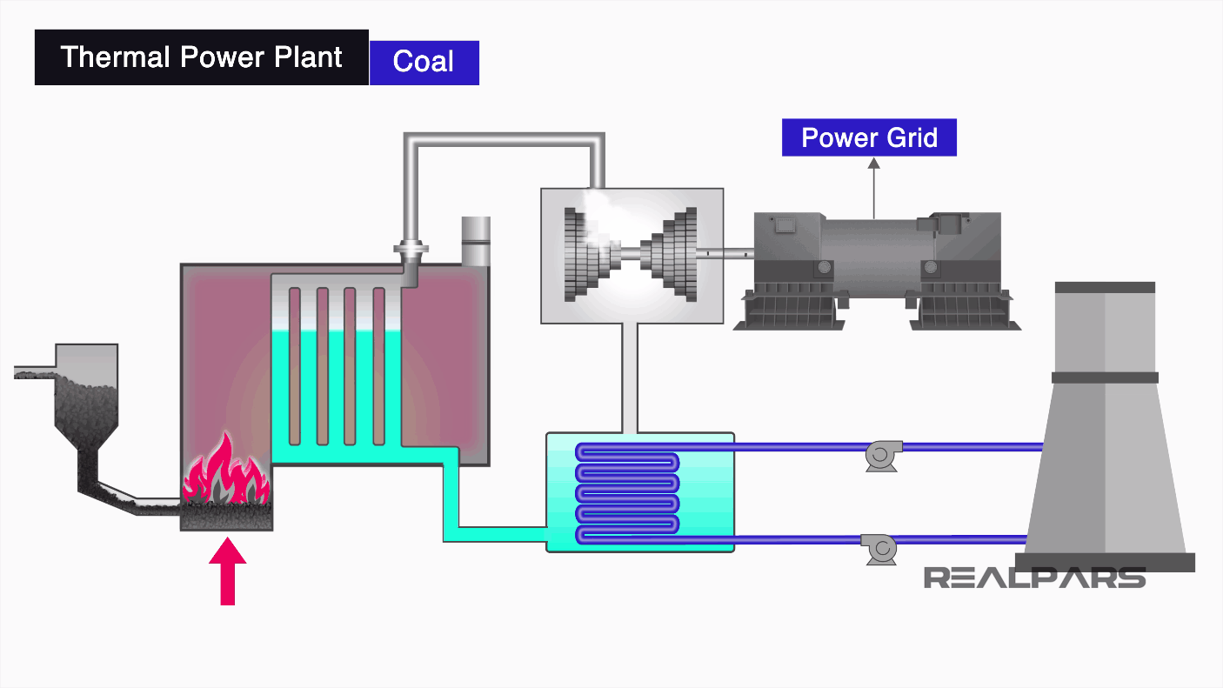
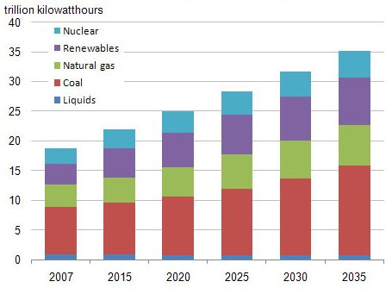
Problem Definition:
Title: Modeling of Thermal Power Plant for multi-output prediction using Artificial Neural Networks.
Thermal Power Plant:
Thermal Power Plants produce electrical energy by using primary energy sources.
Working of Power Plant:
Coal – Furnace – Water – Boiler – Steam – Turbine- Power generator.
Steam- Condenser- Water
Auxiliary equipment: Superheater, desuperheater, damper, etc.
At present, 80 % of the World’s production of electricity is carried out by fossil fuel power plants¹.
[1] International energy outlook report 2019

Slide 3

Problem Definition:
Importance of Thermal Power Plant Modeling:
Cost-efficiency:
Simulated models are more cost-efficient than physical experiments.
Safety Operations:
It is possible to identify the safety range of operations of the devices and parameters.
Optimization:
It is possible to optimize a simulated model to find the optimal range of operation.
Challenges of Thermal Power Plant Modeling:
Highly nonlinear complex multivariate system.
Difficult to build an exact mathematical model.
Sequential depending between the operational parameters.

Slide 4
Related works:
Neural network modeling has become a useful tool for modeling large-scale power plant steam-boiler systems.
DNN:
Irwin et al. [1], Liu et al. [2] & Mohamed et al. also applied feedforward deep neural networks for modeling power plants. In these works, operational parameters are treated as the inputs and power output, temperatures are treated as outputs.
DNN can’t capture the dynamic behavior of thermal power plant data.
CNN:
Abdel-Hamid et al. [3] and Kim et al. [4] applied CNN for the time series data set. Wang et al. and Mehtab et al. [5] showed that CNN can perform better than FNN.
RNN:
Kwang Y. Lee, Ku & Lee et al. used RNN for power plant modeling. Kim et al. [4] used the CNN-LSTM model for modeling the housing energy consumption system.

Slide 5
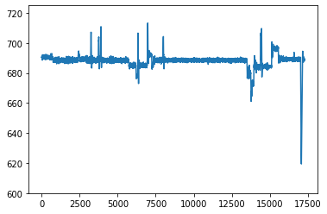
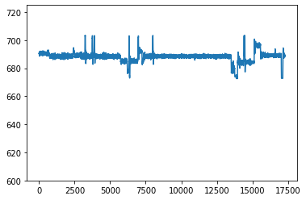
Data preparation:
Data acquisition:
The dataset was collected from an open-source data science platform (Kaggle) that contains a large amount of power plant data.
Dataset contains 116 variables with 17,280 observations.
116 variables include parameters like coal flow rate, feedwater flow, temperature control, sensor positions, etc.
Data preprocessing:
Null value or invalid values detection.
Outliers detection.
Z score = (x -mean) /std. deviation
Normalization of the dataset.

Slide 6
Data preparation:
Training and testing dataset:
Dataset was split into 70:30 training, testing data.
Input variables contain operational parameters like , coal flow, air flow, sensor positions.
Output variables contain power output, feedwater flow, temperatures of valves etc.
Coal Flow,
Air flow,
Damper pressure,
etc
98 operational parameters inputs
Power output
Temperature control unit
Feedwater flow
etc 18 output units
Deep learning model

Slide 7
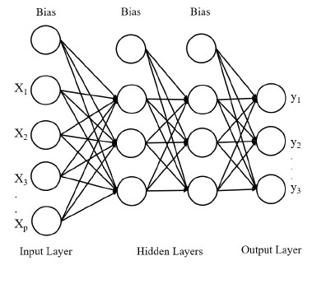
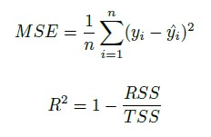
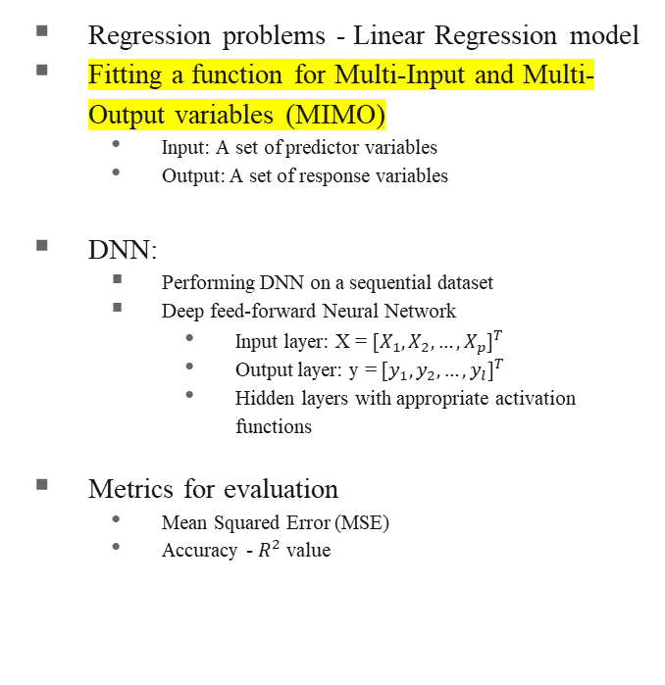
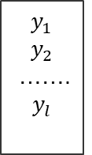
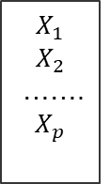
Deep feed-forward Neural Network (DNN)
β‘s
$$X_{1}$$
$$X_{2}$$
……. $X_{p}$
$$y_{1}$$
$$y_{2}$$
……. $y_{l}$
Regression problems - Linear Regression model
Fitting a function for Multi-Input and Multi-Output variables (MIMO)
Input: A set of predictor variables
Output: A set of response variables
DNN:
Performing DNN on a sequential dataset
Deep feed-forward Neural Network
Input layer: X = ${[X_{1},X_{2},…,X_{p}]}^{T}$
Output layer: y = ${[y_{1},y_{2},…,y_{l}]}^{T}$
Hidden layers with appropriate activation functions
Metrics for evaluation
Mean Squared Error (MSE)
Accuracy - $R^{2}$ value
Linear regression model

Slide 8
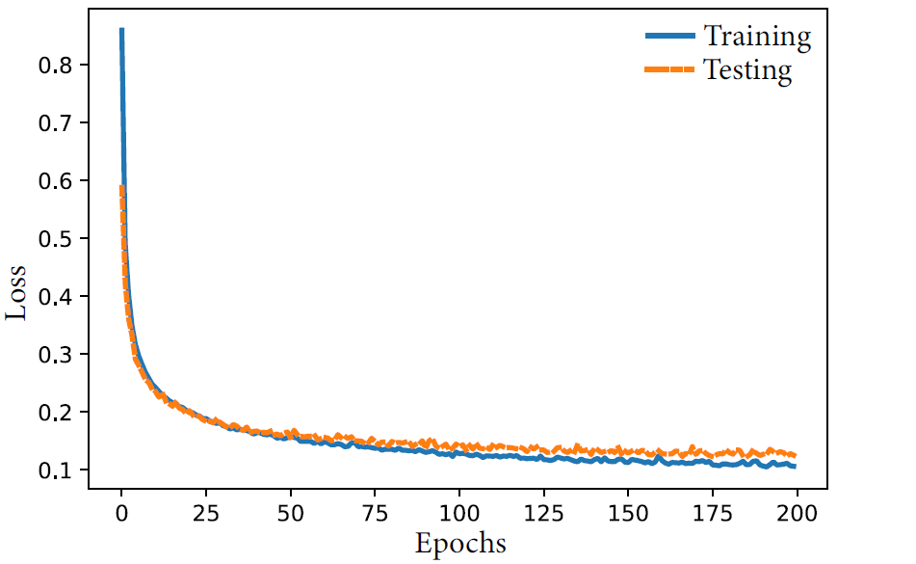
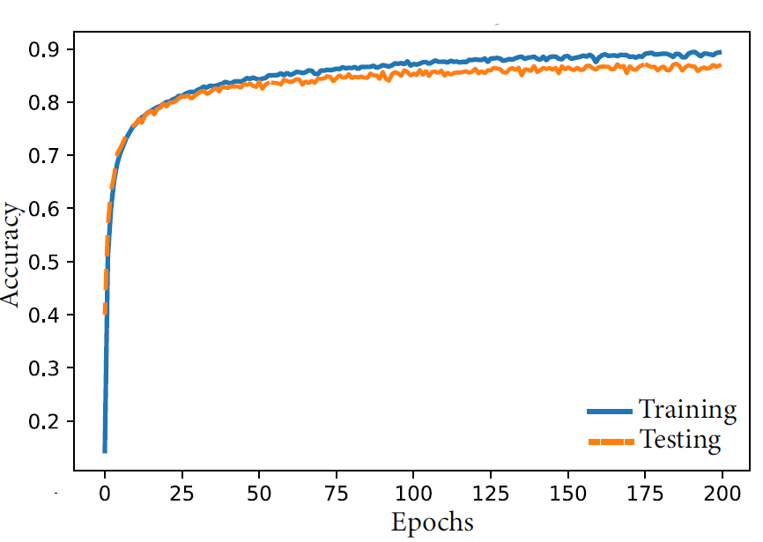
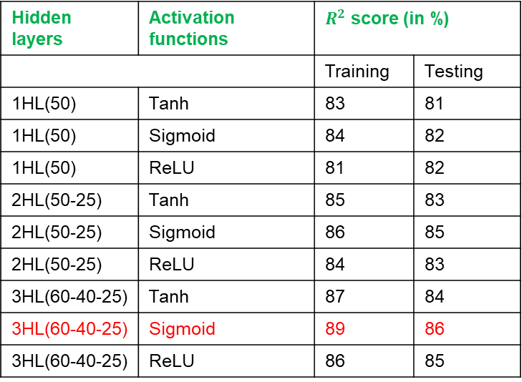
Experiments – DNN Architecture and Results
Hyperparameters
Number of hidden layers - [1, 2, 3]
Number of neurons in each layer – [(50), (50-25), (60-40-25)]
Type of activation function – Sigmoid, hyperbolic tangent (Tanh), ReLU
Hidden layers | Activation functions | $R^{2}$ score (in %)
 |  | Training | Testing
1HL(50) | Tanh | 83 | 81
1HL(50) | Sigmoid | 84 | 82
1HL(50) | ReLU | 81 | 82
2HL(50-25) | Tanh | 85 | 83
2HL(50-25) | Sigmoid | 86 | 85
2HL(50-25) | ReLU | 84 | 83
3HL(60-40-25) | Tanh | 87 | 84
3HL(60-40-25) | Sigmoid | 89 | 86
3HL(60-40-25) | ReLU | 86 | 85

Slide 9
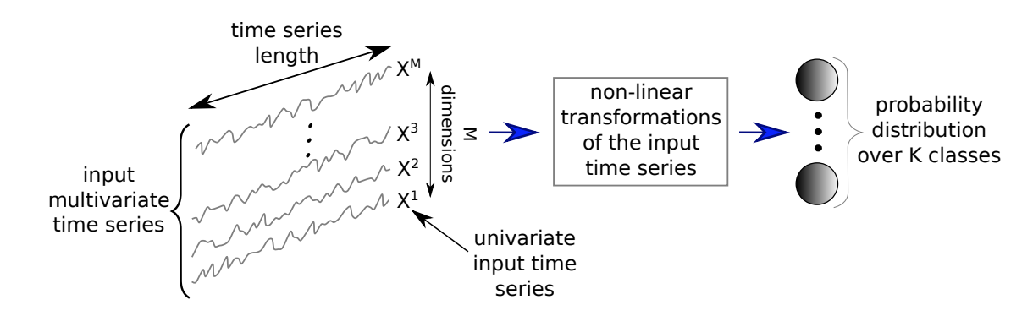
Convolutional Neural Networks (CNN)
Deep FNN and RNN are popular for sequential dataset
CNN - widely popular for image classification problems
Ability to process large images
Captures spatial features
Also, CNN works well for sequential data with time stamps
Proof from existing literature
Fawaz et al., worked on time series dataset for classification
Exploring CNN for regression setting

Slide 10
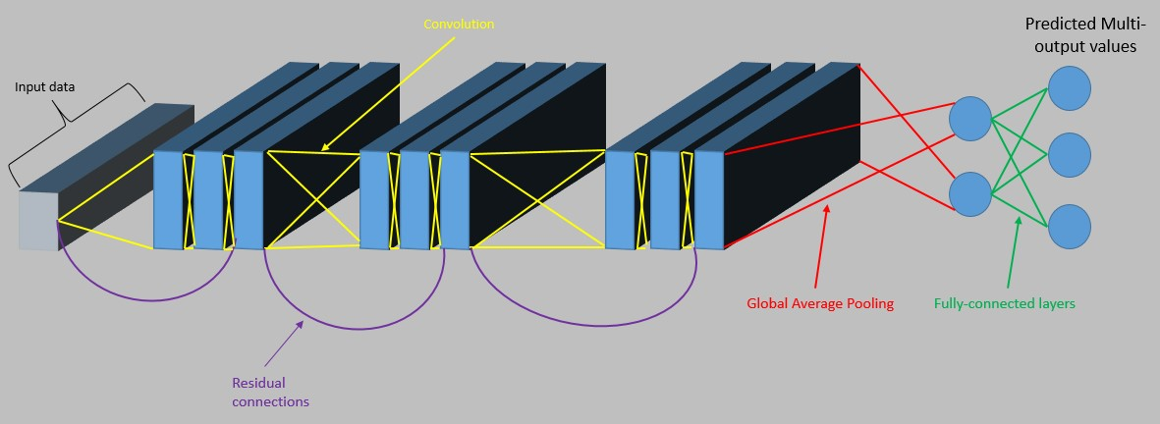
CNN Models
Simple CNN model
Deep CNN model
Residual Network (ResNet)
INPUT -> [Conv1D -> ReLU -> MaxPool1D]*2 -> FC -> ReLU -> FC

Slide 11
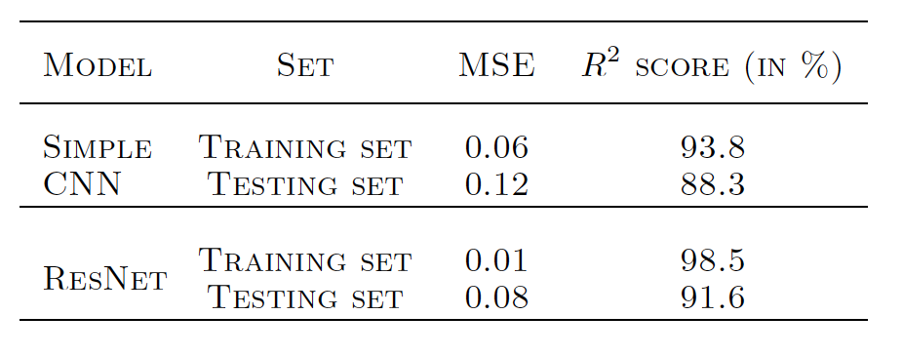
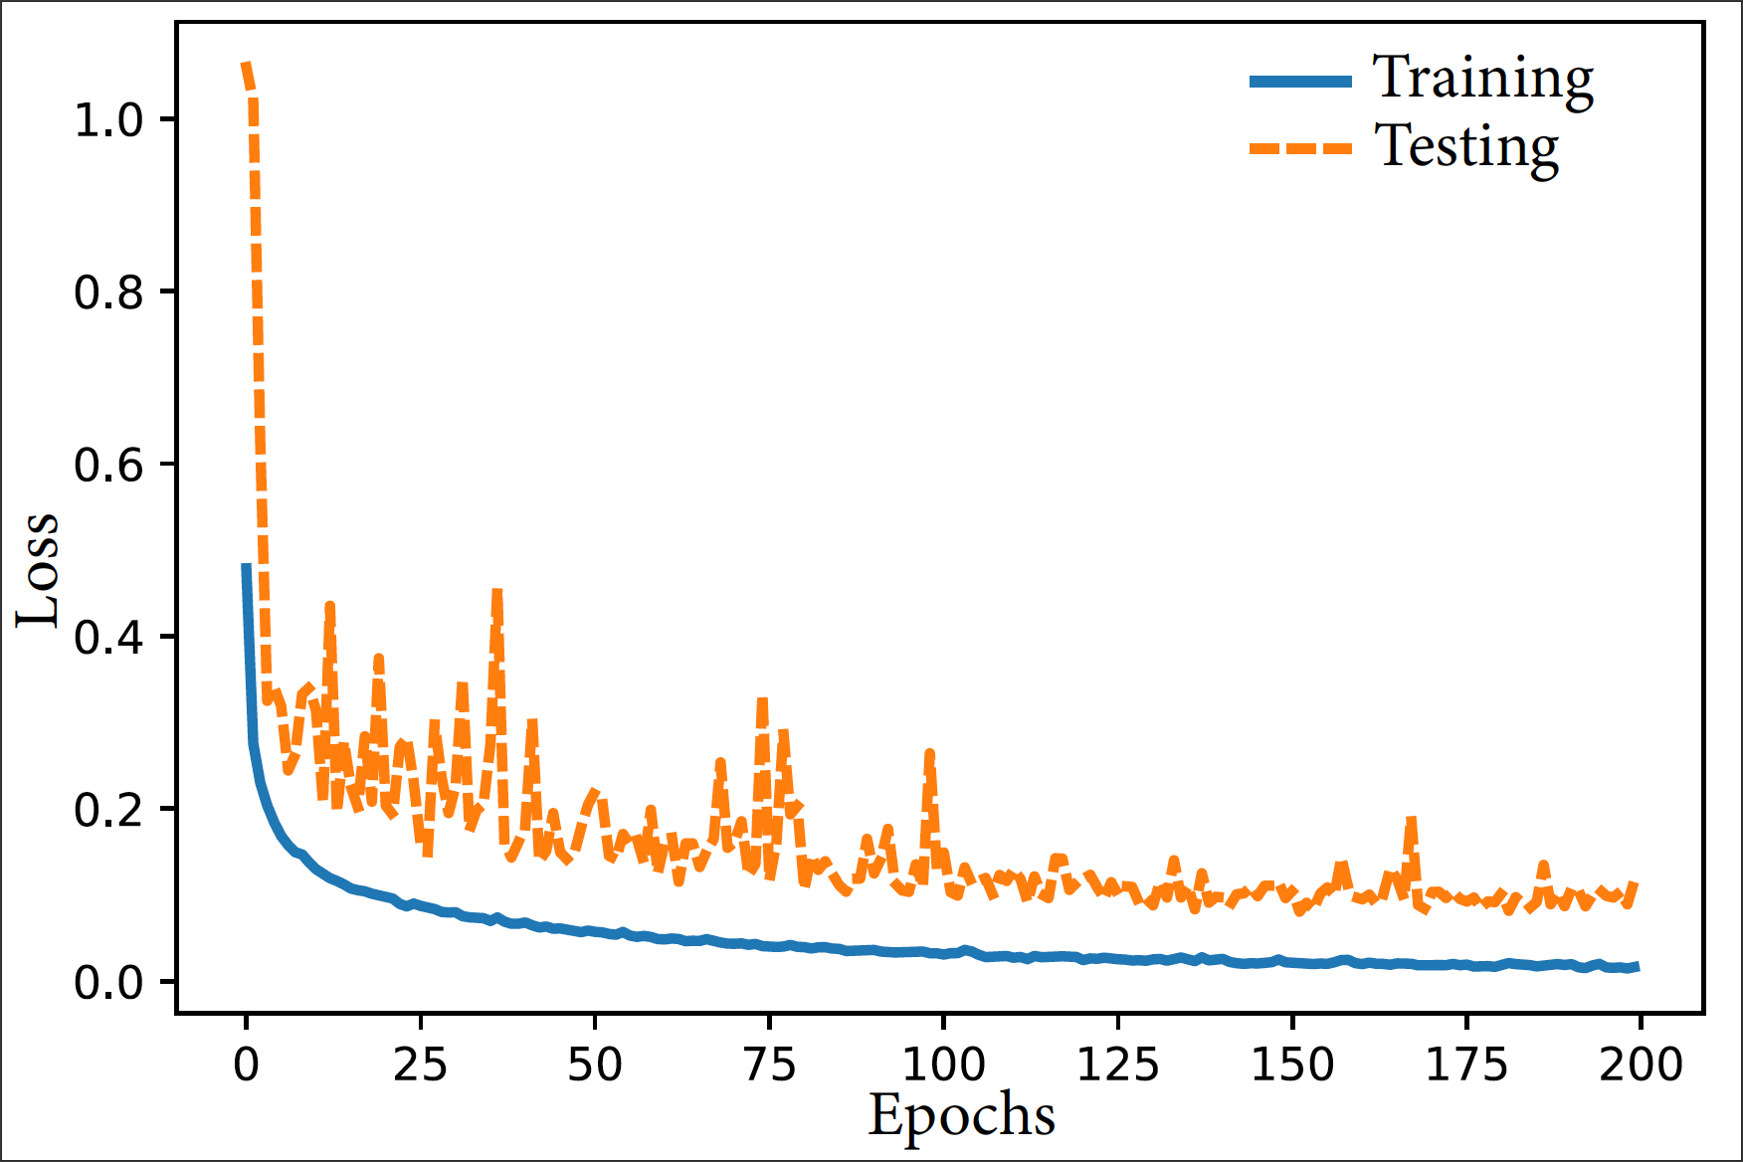
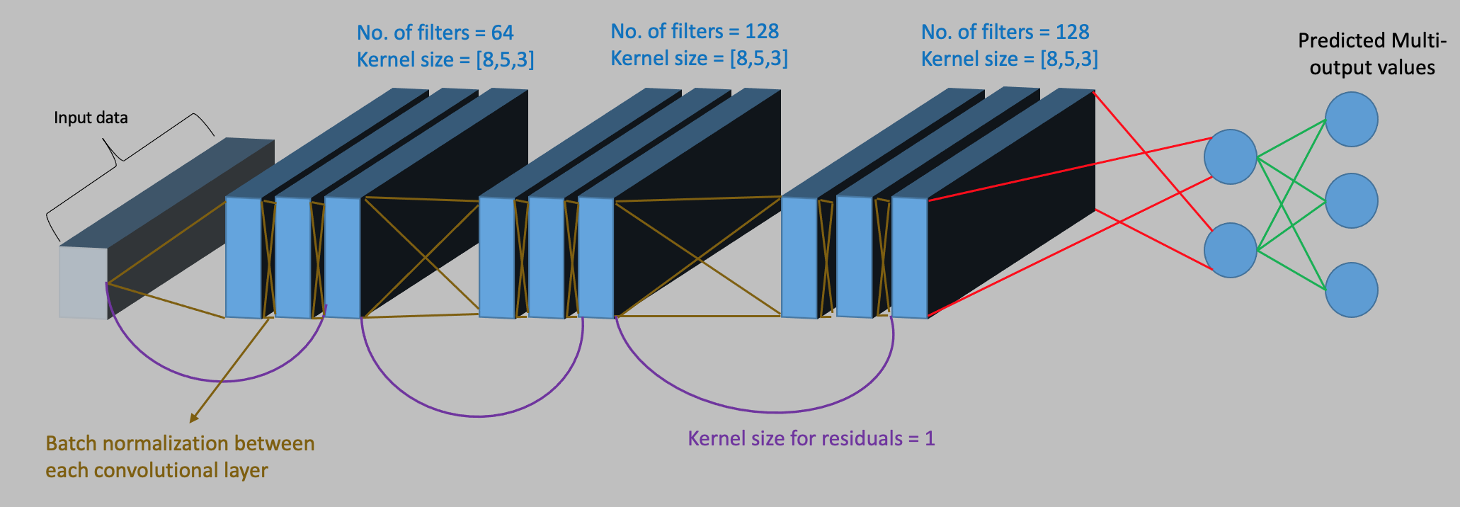
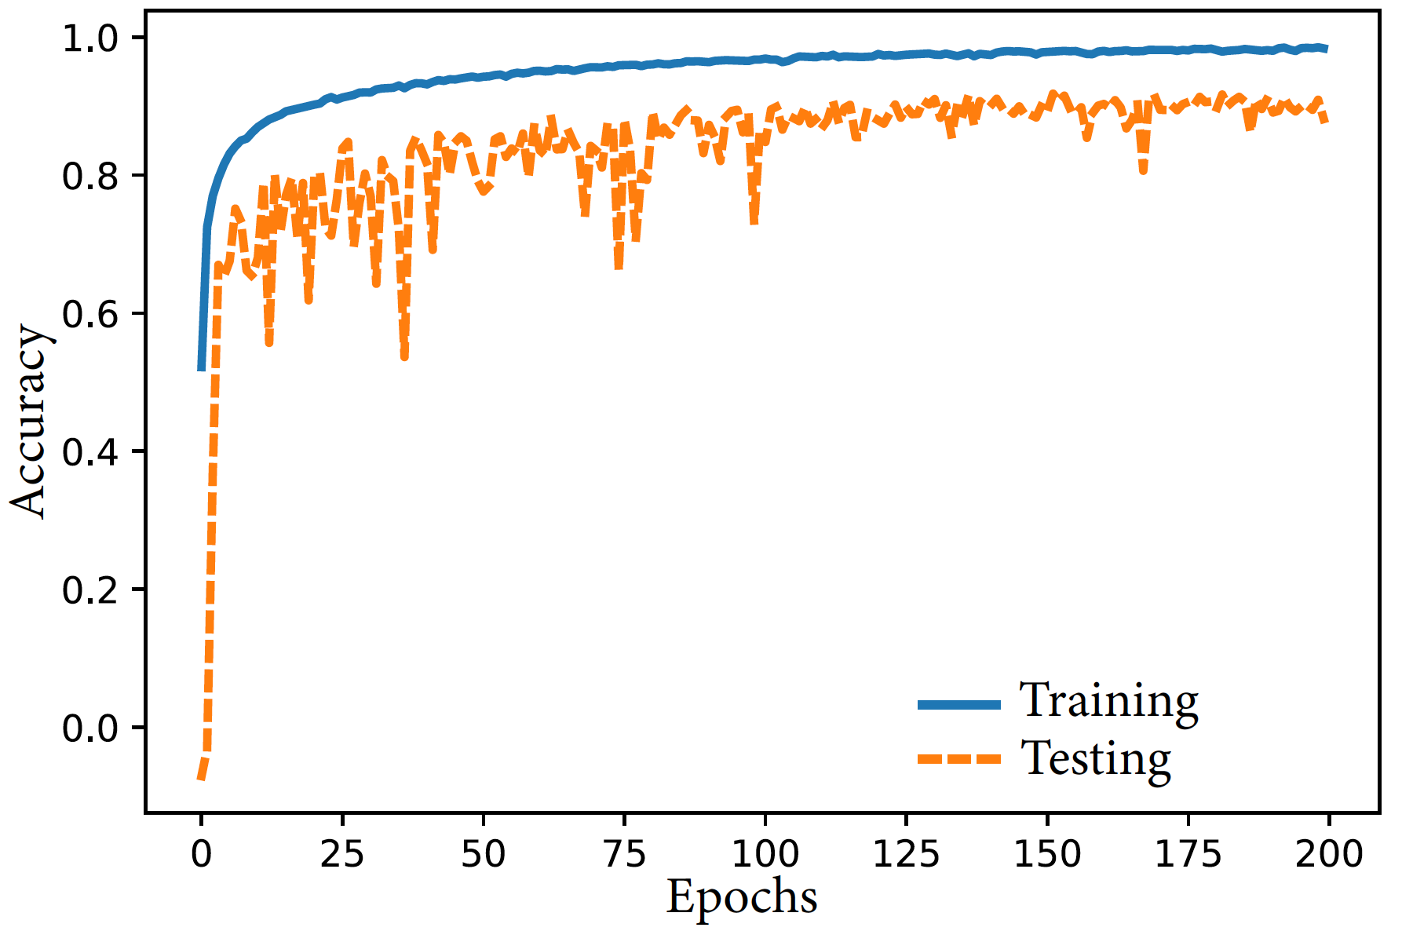
Experiments – Architectures and Results
Simple CNN model architecture:
Two convolutional and two pooling layers with FC layers
Number of filters – [32, 64]
Kernel size – [8, 5]
Pooling size - 2
Optimizer – Adam
Loss – MSE
ResNet Architecture:
Three residual blocks with 3 convolutional layers in each block

Slide 12
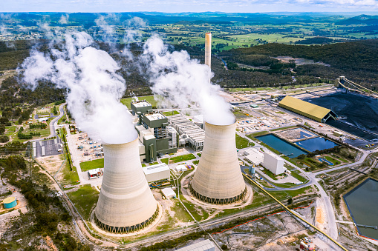
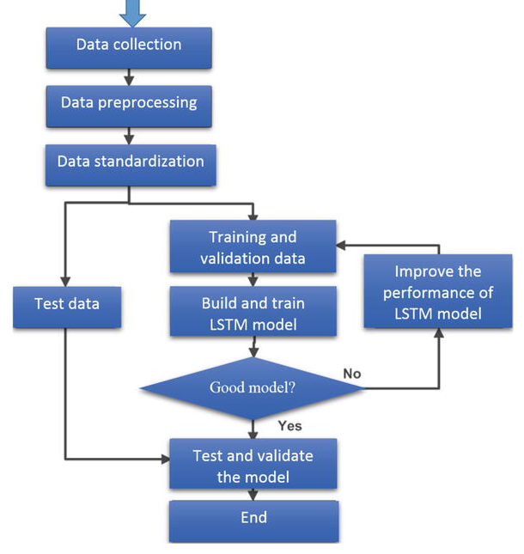
Methods applied: RNN
Why LSTM?
Keeps most relevant portion of history in its memory
Prevents vanishing gradient problem (gated structure)
LSTM performed better among all the popular RNNS
LSTM: high accuracy, robustness, parallel computation ability and the capacity to fully understand the complex non-linear property
Ref: Harrou, F., Kadri, F., & Sun, Y. (2020). Forecasting of photovoltaic solar power production using LSTM approach. Advanced Statistical Modeling, Forecasting, and Fault Detection in Renewable Energy Systems, 3.

Slide 13
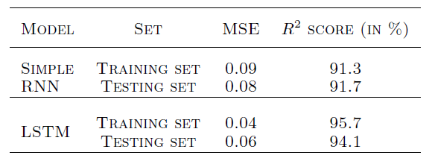
Experiments: RNN
256 layers LSTM (tanh)
Feature scaling performed on both the input and output
Dropout: removes the non-output units of the network, introduced between layers
LSTM performed better then Simple RNN in terms of R2 score and validation losses
512 layers LSTM (relu)
512 layers Dense (relu)
256 layers Dense (tanh)
128 layers Dense (tanh)
64 layers Dense (tanh)
32 layers Dense (relu)
18 layers Dense (linear)

Slide 14
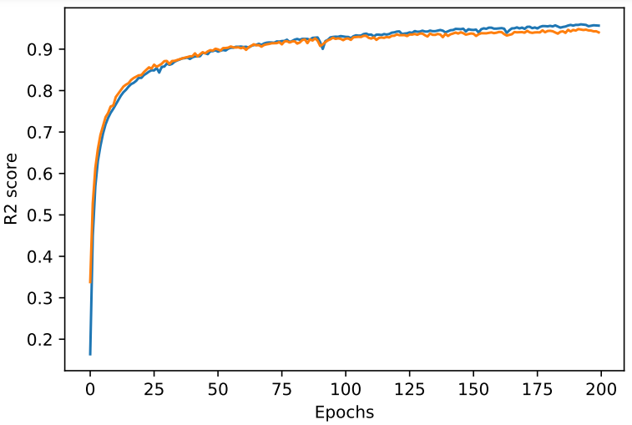
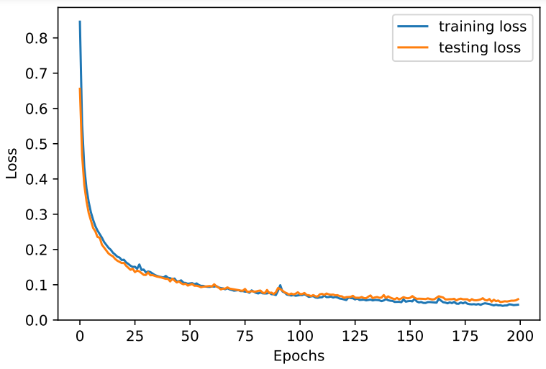
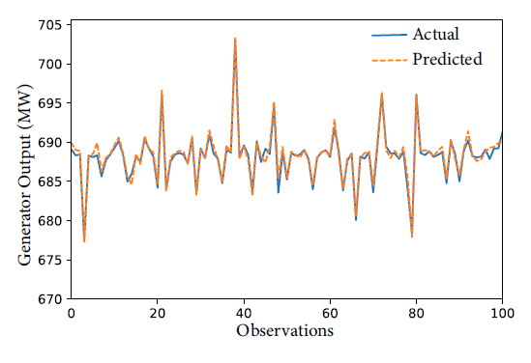
Experiments and results: RNN
R2 score after performing 200 epochs 0.94
Validation loss 0.0590
Predicted power captures the trend in the validation set

Slide 15
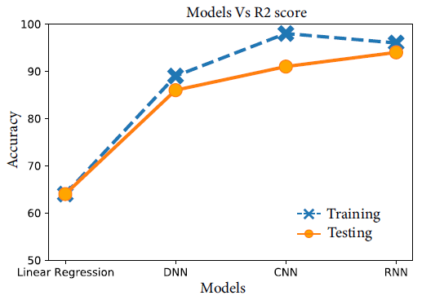

Conclusion
R2 score: LSTM based RNN > CNN > DNN
The neural network-based regression models can be used for predicting the temperature of important lines.
Knowing the temperature and pressure will be helpful in design considerations
It can also be used for predicting the RH-DSH feed water flow and minimize cost
Future scope includes finding the optimal range of parameters for the operation of the powerplant

Slide 16
References
[1] Irwin, G, Brown, M, Hogg, B, and Swidenbank, E. Neural network modelling of a 200 mw boiler system. IEE proceedings-Control theory and Applications, 142(6):529–536, 1995.
[2] Liu, Xiang-Jie, Lara-Rosano, Felipe, and Chan, CW. Neurofuzzy network modelling and control of steam pressure in 300 mw steam-boiler system. Engineering Applications of Artificial Intelligence, 16(5-6): 431–440, 2003.
[3] Abdel-Hamid, Ossama, Mohamed, Abdel-rahman, Jiang, Hui, and Penn, Gerald. Applying convolutional neural networks concepts to hybrid nn-hmm model for speech recognition. In 2012 IEEE international conference on Acoustics, speech and signal processing (ICASSP), pp. 4277–4280. IEEE, 2012.
[4] Kim, Yoon. Convolutional neural networks for sentence classification. In Proceedings of the 2014 Conference on Empirical Methods in Natural Language Processing (EMNLP), pp. 1746–1751, Doha, Qatar, October 2014. Association for Computational Linguistics. doi: 10.3115/v1/D14-1181. URL https: //aclanthology.org/D14-1181.
[5] Mehtab, Sidra and Sen, Jaydip. Stock price prediction using cnn and lstm-based deep learning models. In 2020 International Conference on Decision Aid Sciences and Application (DASA), pp. 447–453. IEEE,
2020.
Acknowledgement
The team would like to thank Dr. Hadis Anahideh for her guidance and teaching different advanced Machine Learning concepts.

Slide 17
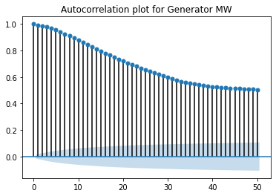
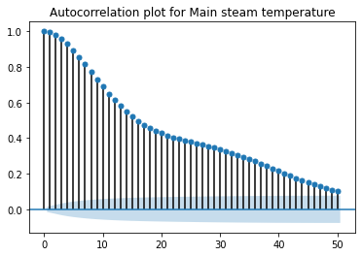
Appendix

